Slide 1
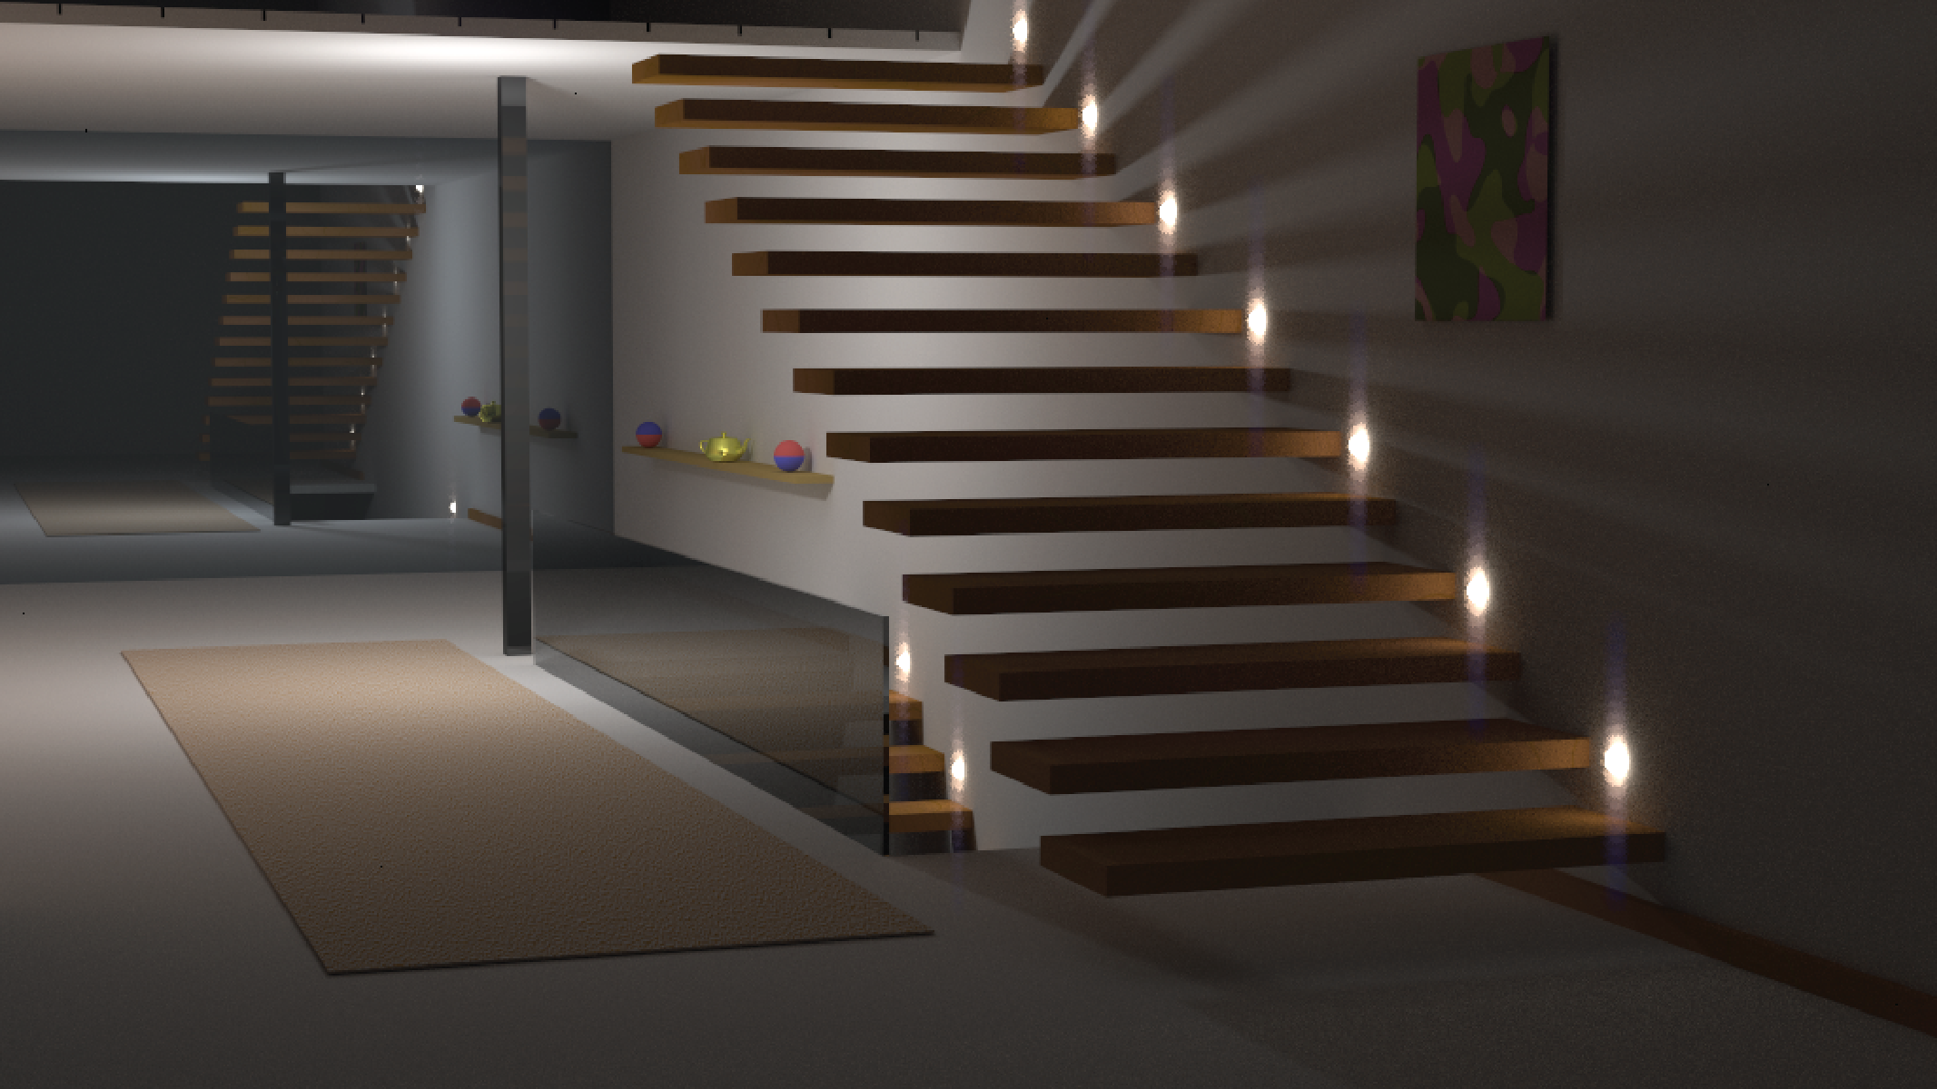



Rayground: An Online Educational Tool for Ray Tracing
https://www.rayground.com/ https://twitter.com/rayground_com https://github.com/cgaueb/rayground
Lecturer: name
Winter/Spring Semester 202x/202x

Slide 2
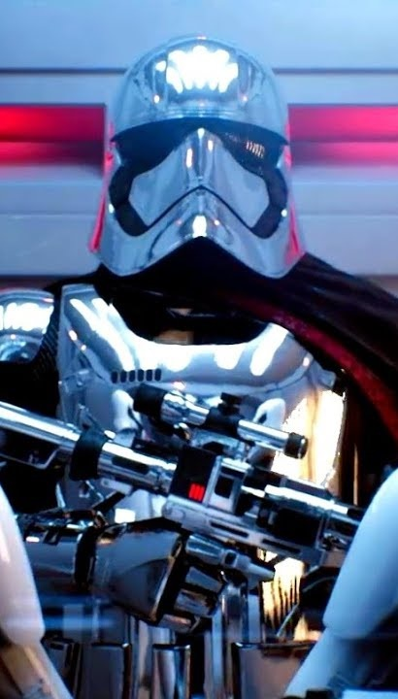
Lecture Outline
Unreal Engine real-time ray-tracing “Star Wars” demo
Why
What
How
Where

Slide 3
Why

Slide 4
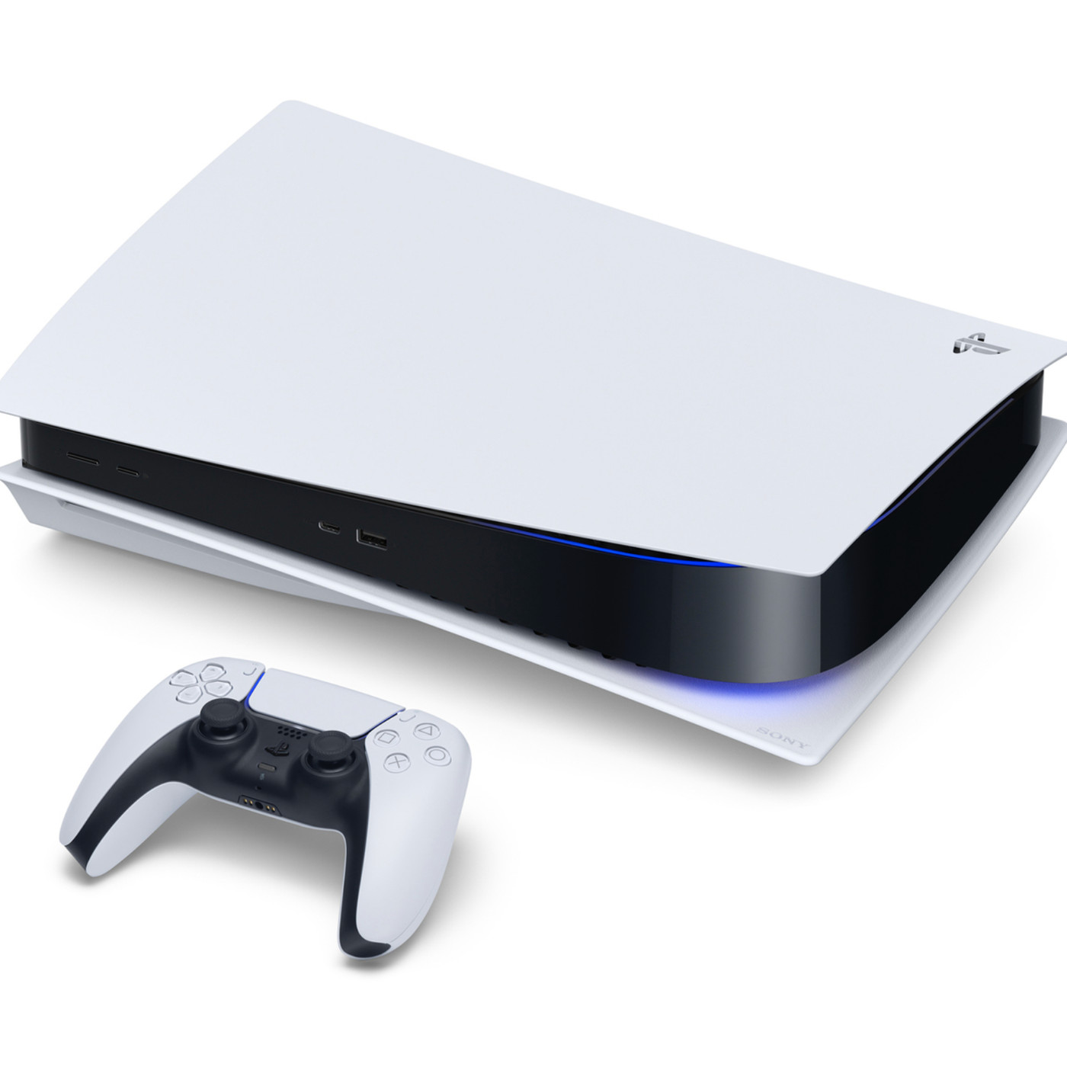
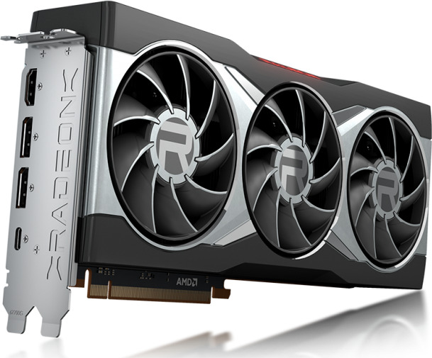
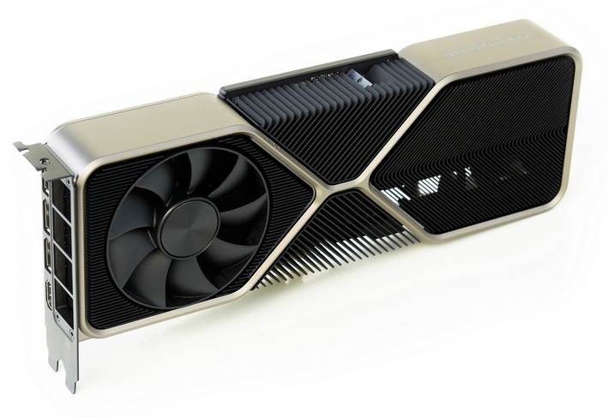
Ray Tracing in Education
Ray Tracing is a core teaching subject in Computer Graphics courses
Undergraduate courses are mostly built around the rasterization pipeline
Graduate syllabi need to cover a wider range of advanced topics
Transition from Rasterization to Ray Tracing is often hard
Hardware-accelerated Ray Tracing is here
AMD Radeon RX 6800
NVIDIA GeForce RTX 3080
Sony PlayStation 5

Slide 5
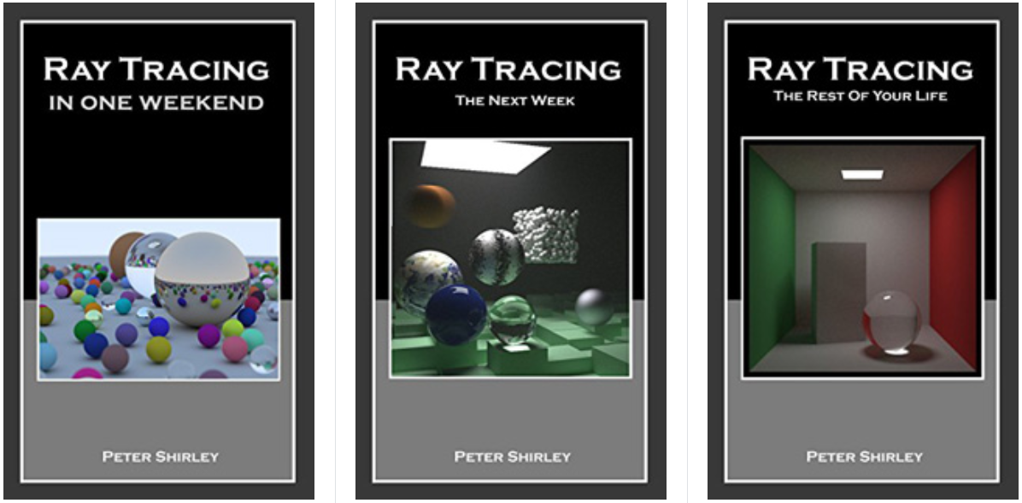
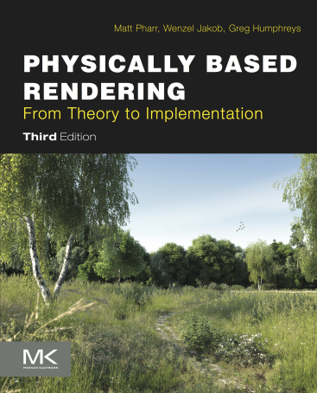
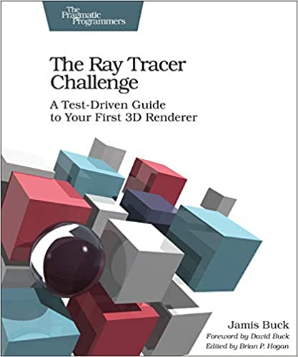
Ray Tracing Books
github.com/RayTracing/raytracing.github.io
pbr-book.org
raytracerchallenge.com

Slide 6
Ray Tracing APIs
Ray tracing is rapidly being introduced in modern graphics APIs
D3D12, Vulkan and OptiX offer great facilities for high performance ray tracing but:
They are low-level APIs, not suitable for introductory courses
Implementation maturity varies across devices
Heavily dependent on software and hardware capabilities
Complex Installation instructions
Frequently updated API (deprecated lab exercises)
Dependencies
A CPU framework (Embree) could be developed but,
Slow

Slide 7
World Wide Web
Pros
By far the platform with the biggest outreach
Great choice for the deployment of educational tools
Sandboxed environment
International open standards
WebGL standard
Cons
No support for ray tracing acceleration
WebGL is very limited in terms of GPGPU computing
Sandboxed environment

Slide 8
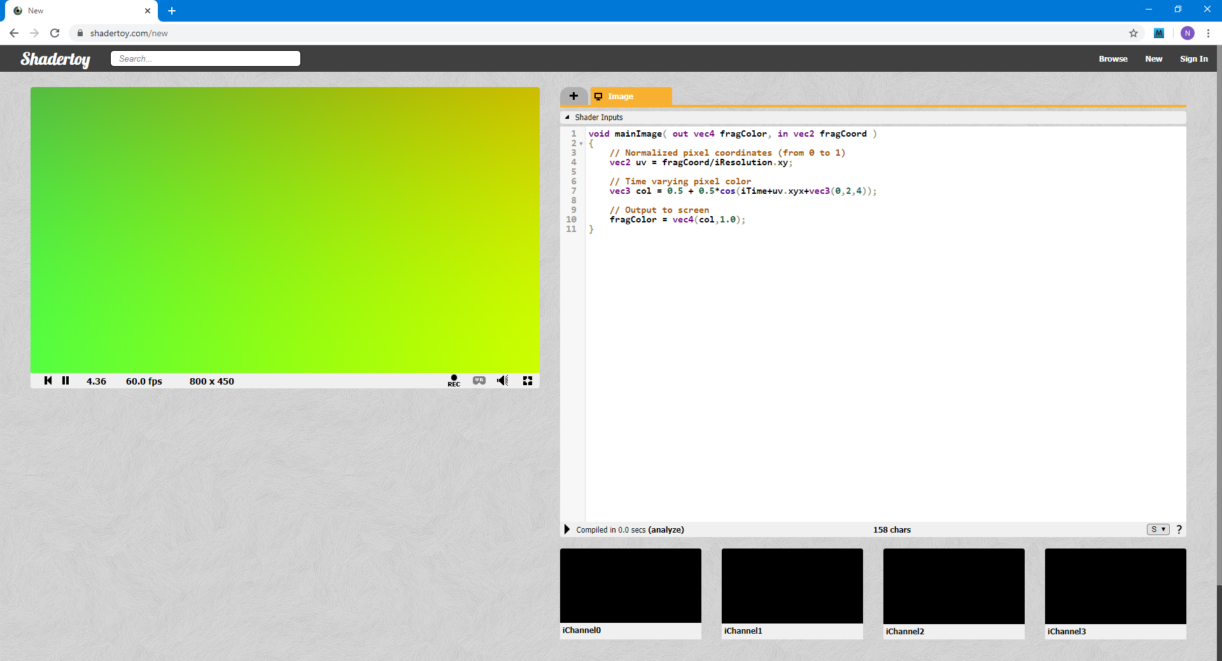
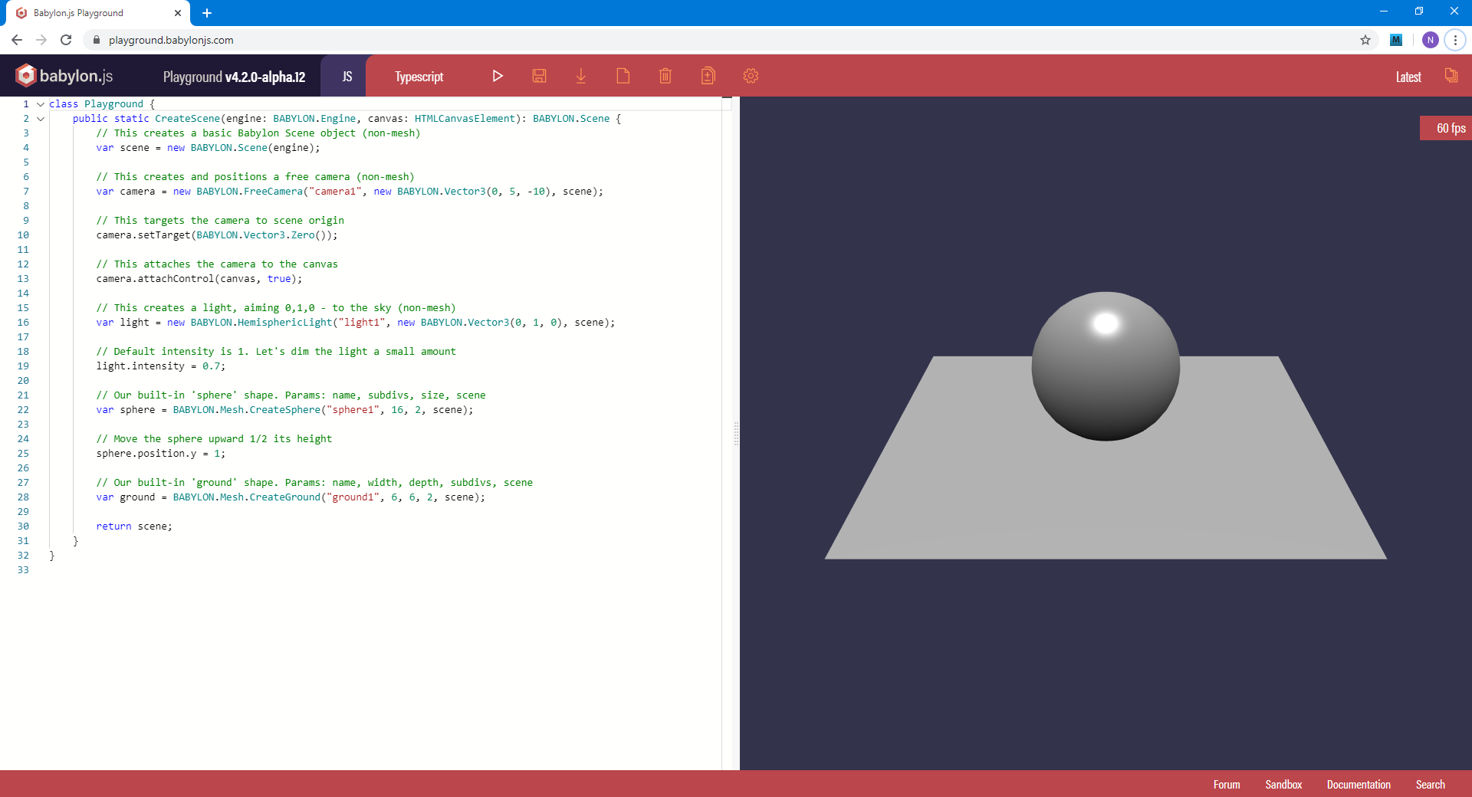
Web-based Graphics Prototyping
shadertoy.com
playground.babylonjs.com

Slide 9
What

Slide 10
Rayground Design (1)
Goals
Highly accessible platform / cross-device support
Interactive education tool with emphasis on rapid prototyping
Enrich both class and lab courses / remote teaching
Smooth transition from rasterization to ray tracing
Demystify ray tracing fundamentals
Modern API design
Non-Goals
A complete replacement for modern shader-based learning with OpenGL
Yet another fully-featured API for programming ray tracing algorithms

Slide 11
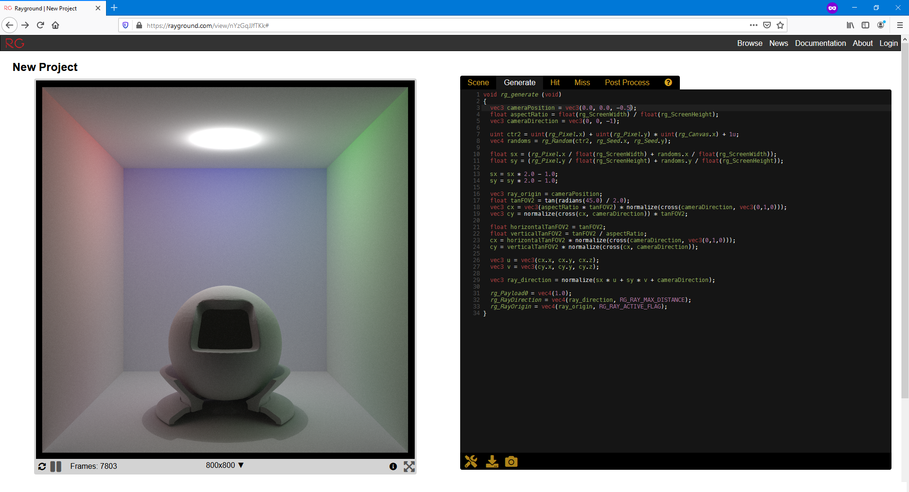
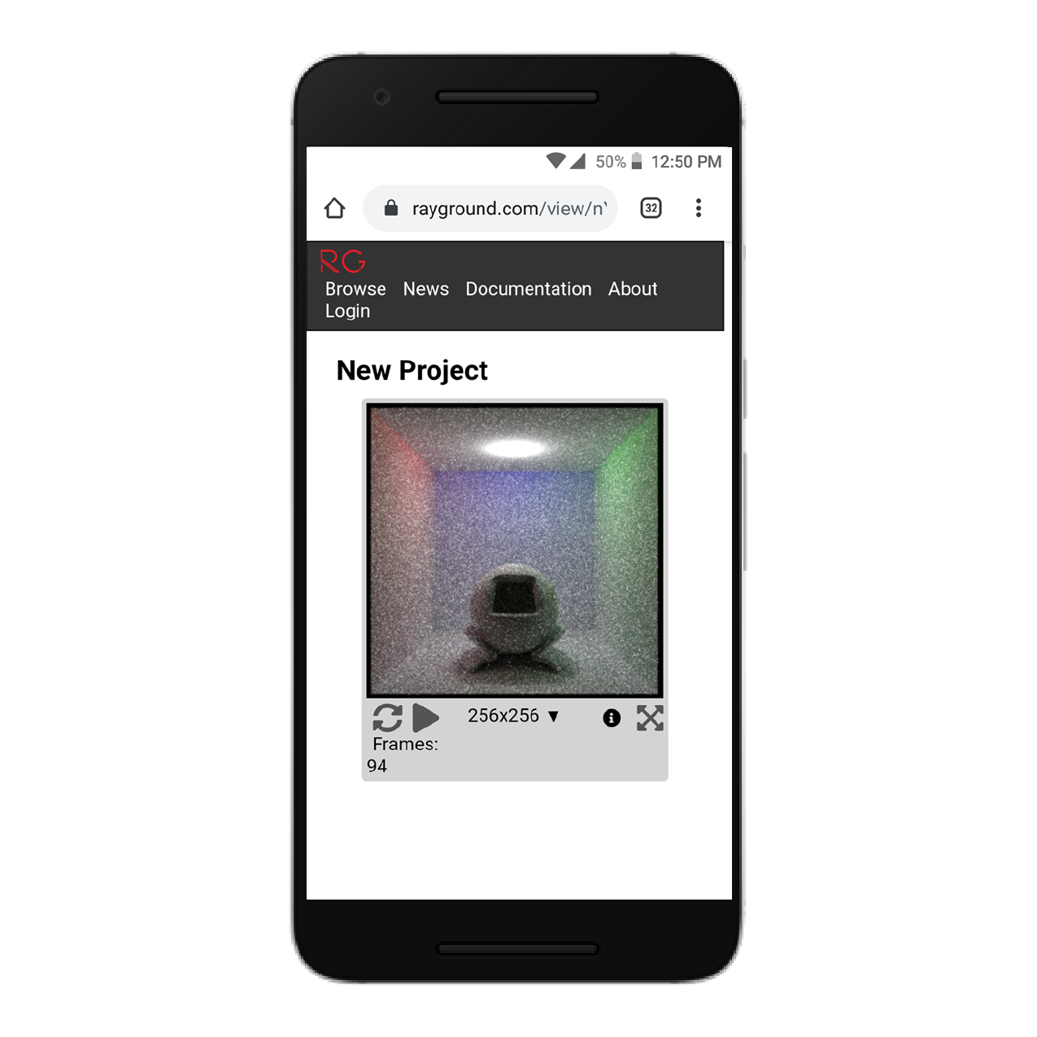
Rayground Design (2)
works on any platform that has a WebGL2-compliant browser (no plugins required)

Slide 12
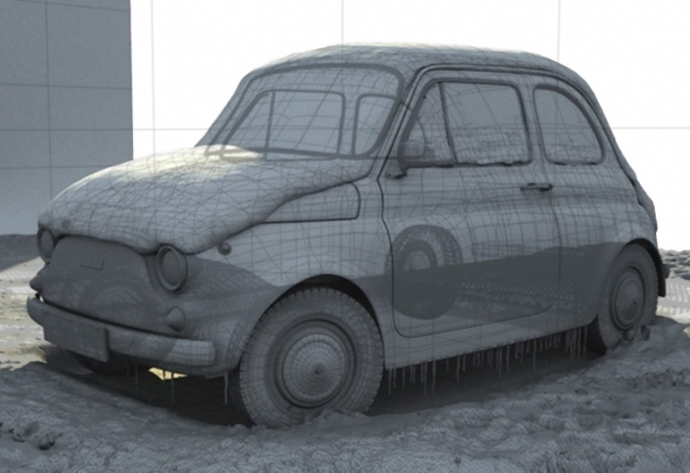
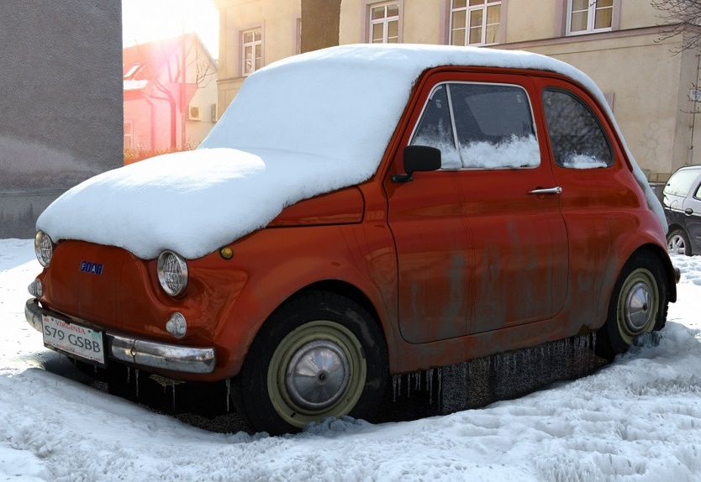
Rayground Pipeline (1)
Scene
geometry
materials

Slide 13
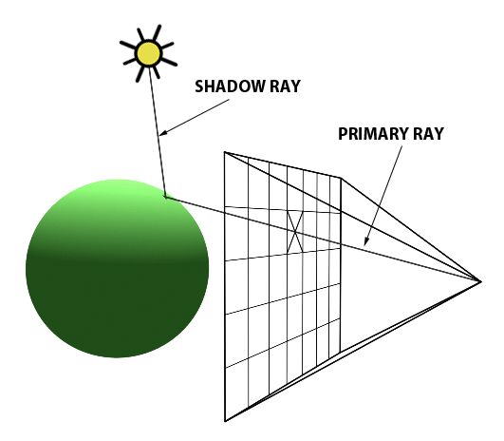
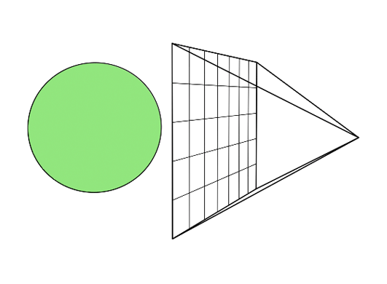
Rayground Pipeline (2)
Scene
Generate
Ray
Intersection
https://www.scratchapixel.com/

Slide 14
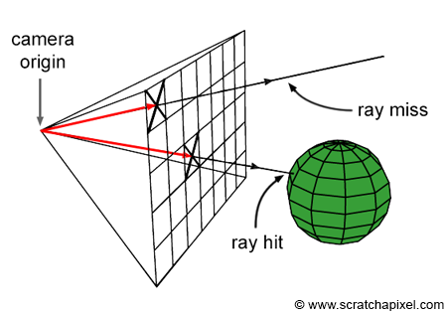
Rayground Pipeline (3)
Scene
Hit
Generate
Ray
Intersection
Hit?
Miss

Slide 15
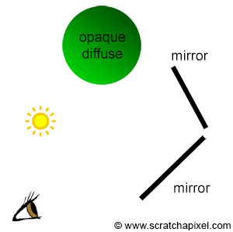
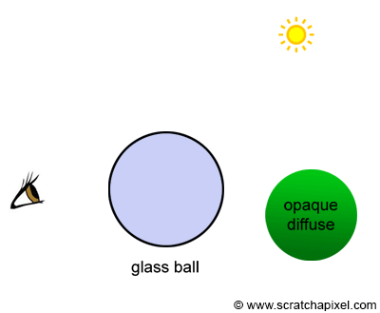
Rayground Pipeline (4)
Scene
Hit
Generate
Ray
Intersection
Hit?
End?
Miss
No
Ray

Slide 16
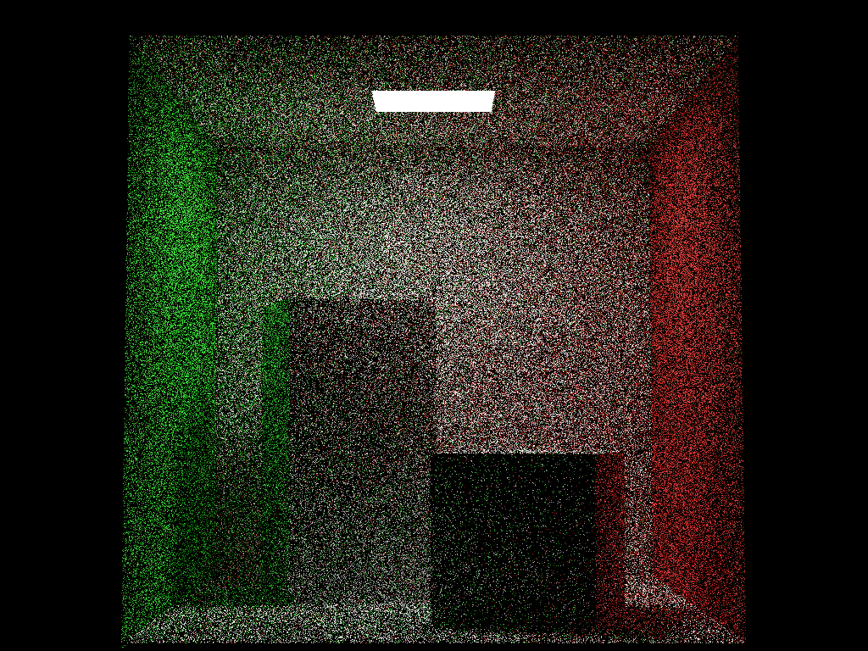
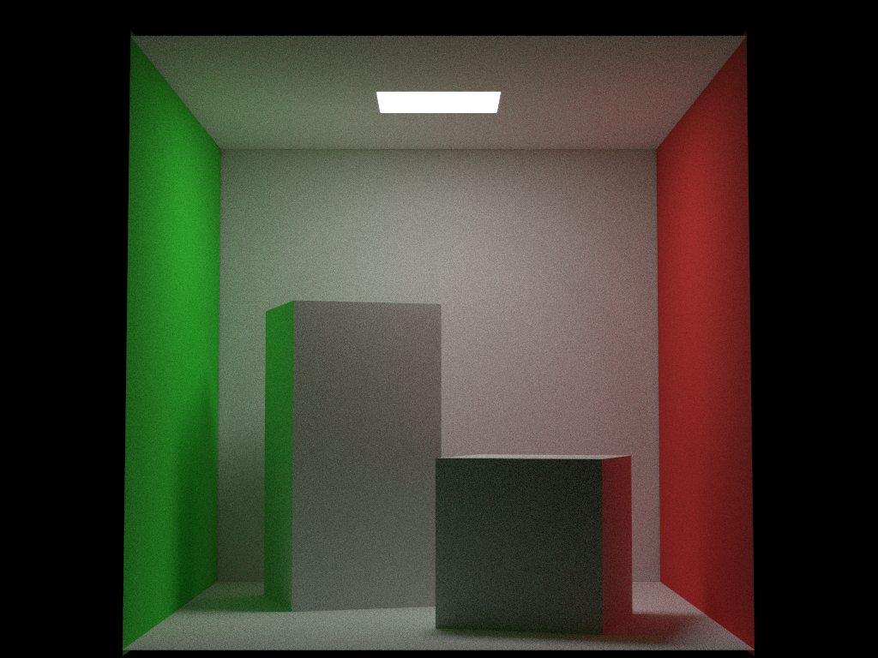
Rayground Pipeline (5)
Scene
Hit
Generate
Ray
Intersection
Yes
Accumulation Buffer
Hit?
End?
Miss
No
Ray
Progressive path tracing

Slide 17
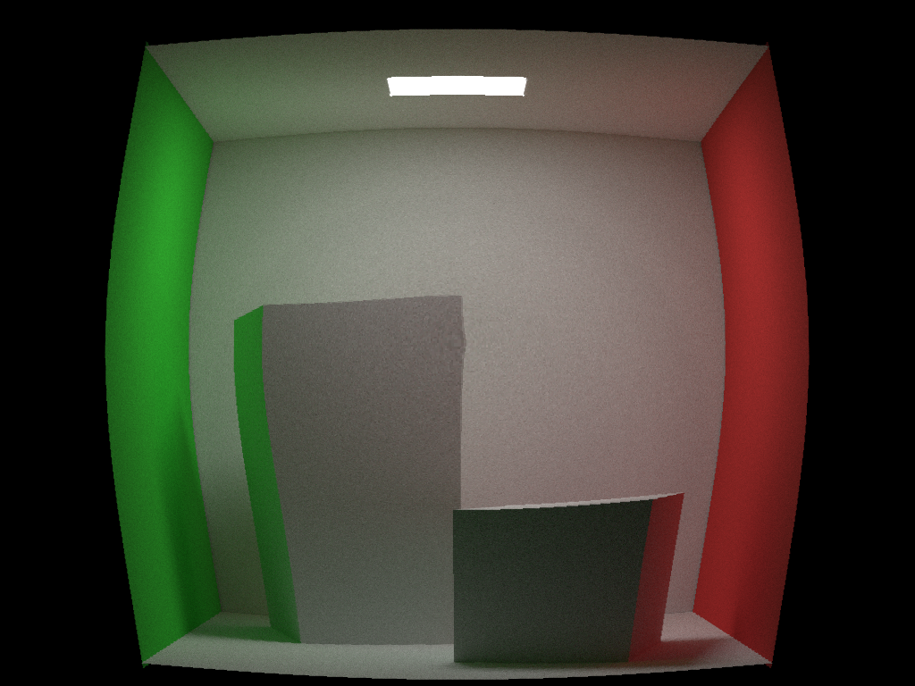
Rayground Pipeline (6)
Scene
Hit
Generate
Ray
Intersection
Yes
Accumulation Buffer
Color
Post Process
Hit?
End?
Miss
No
Ray
Lens Correction (VR rendering)

Slide 18
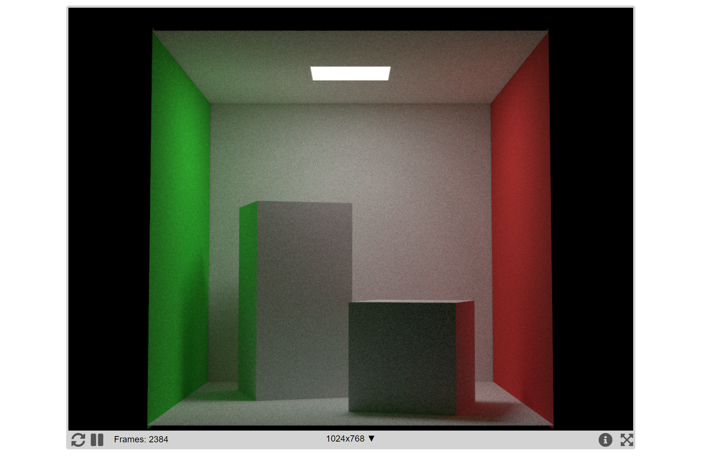
Rayground Pipeline (7)
Scene
Hit
Generate
Ray
Intersection
Yes
Accumulation Buffer
Color
Post Process
Color
Canvas
Hit?
End?
Miss
No
Ray

Slide 19
How

Slide 20
Rayground Programmable Pipeline (1)
Fixed Stage
Programmable Stage
Declarative Stage
Scene
Hit
Generate
Ray
Intersection
Yes
Accumulation Buffer
Color
Post Process
Color
Canvas
Hit?
End?
Miss
No
Ray
User code is provided for each programmable stage and is called every time the relevant event is triggered.
Acceleration Data Structure management and accumulation operations are the only actions, not in direct control of the user.

Slide 21
Rayground Programmable Pipeline (2)
Scene Description
Object properties
Simulation settings
Ray Generation Stage
Primary rays (camera, light sources e.t.c.)
Miss/Hit Stage
Intersection information for shading
Secondary ray generation
Post Process Stage
Global access to accumulation buffer and other AOVs
Various screen-space effects

Slide 22
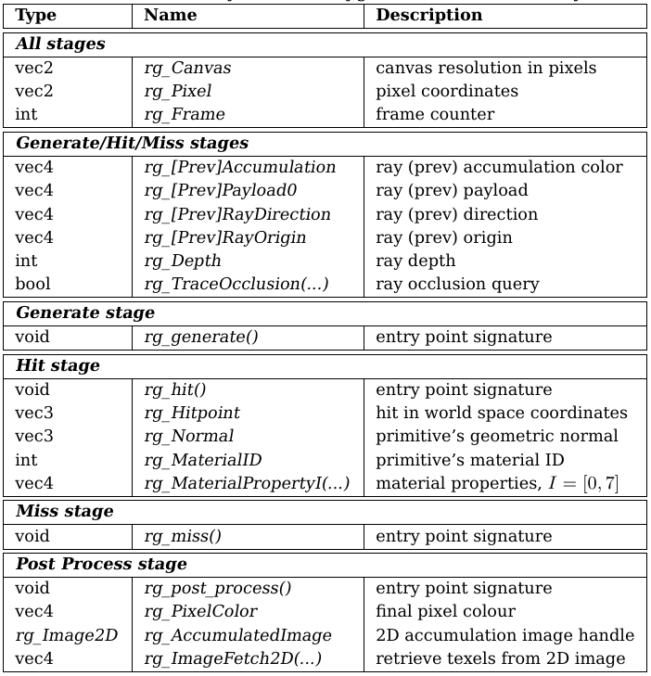
Rayground API - Overview
Simple & intuitive
Mapping to fundamental concepts of Ray Tracing
Correspondence to the “gl_” namespace
*Complete table: https://www.rayground.com/documentation

Slide 23
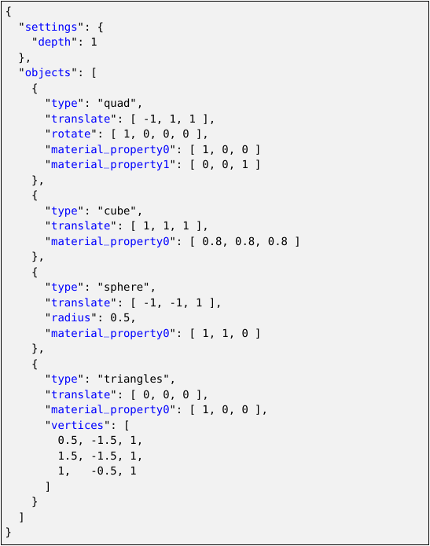
Rayground API – Scene Description Stage
Simple custom JSON format
Settings
simulation properties (e.g. recursion depth)
Objects
Scene geometry
Supports several basic shapes and triangle soups
For each object, the user can specify:
3D positioning and scaling via TRS transformation, if “model” matrix is present, it is used instead.
Object properties which become available during Hit events

Slide 24
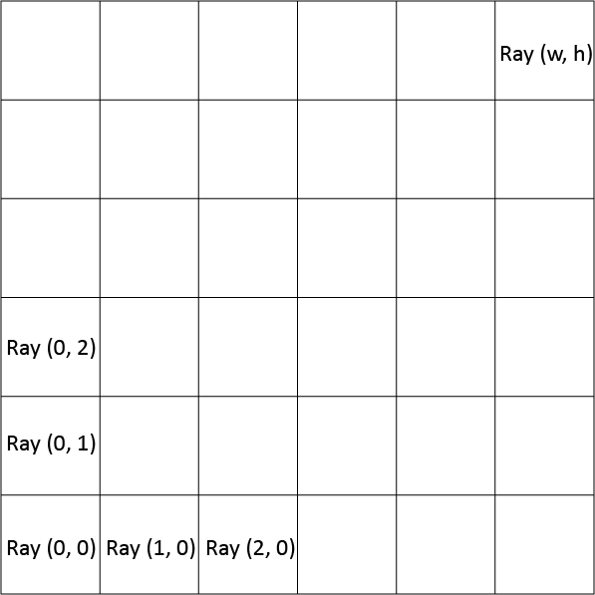
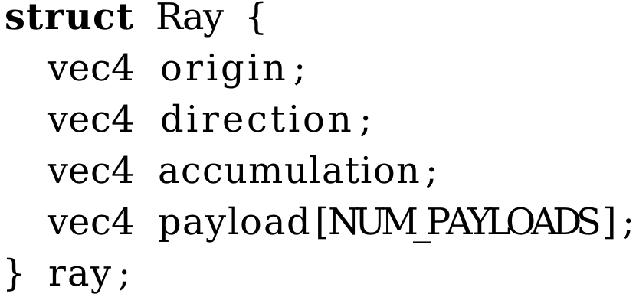
Rayground API – Ray Generation Stage
Generate primary rays in parallel for each pixel
Typically used to set up a virtual camera
The user has access to the canvas dimensions and each pixel’s coordinates
Rays carry a payload and the pixel’s accumulation value
The user “submits” primary rays for intersection by appropriately setting the “rg_RayOrigin” and “rg_RayDirection” built-ins
Ray payload and accumulation are initialized through “rg_PayloadX” and “rg_Accumulation”

Slide 25
Rayground API – Hit/Miss Stage
Previously submitted rays are intersected (or not) with the scene
A Miss or Hit event is triggered
Local shading and next event estimation commonly take place in this stage
In-shader visibility queries can be performed using “rg_TraceOcclusion”
The user “submits” secondary rays for intersection by appropriately setting the “rg_RayOrigin” and “rg_RayDirection” built-ins
Ray payload and accumulation are updated through “rg_PayloadX” and “rg_Accumulation”
The process continues until the “max depth” iteration is reached or the ray is set to “inactive”
Miss
Miss
Miss
Miss
Miss
Miss
Miss
Hit
Miss
Miss
Miss
Miss
Miss
Hit
Hit
Hit
Miss
Miss
Miss
Hit
Hit
Hit
Hit
Miss
Miss
Hit
Hit
Hit
Miss
Miss
Miss
Miss
Miss
Miss
Miss
Miss

Slide 26
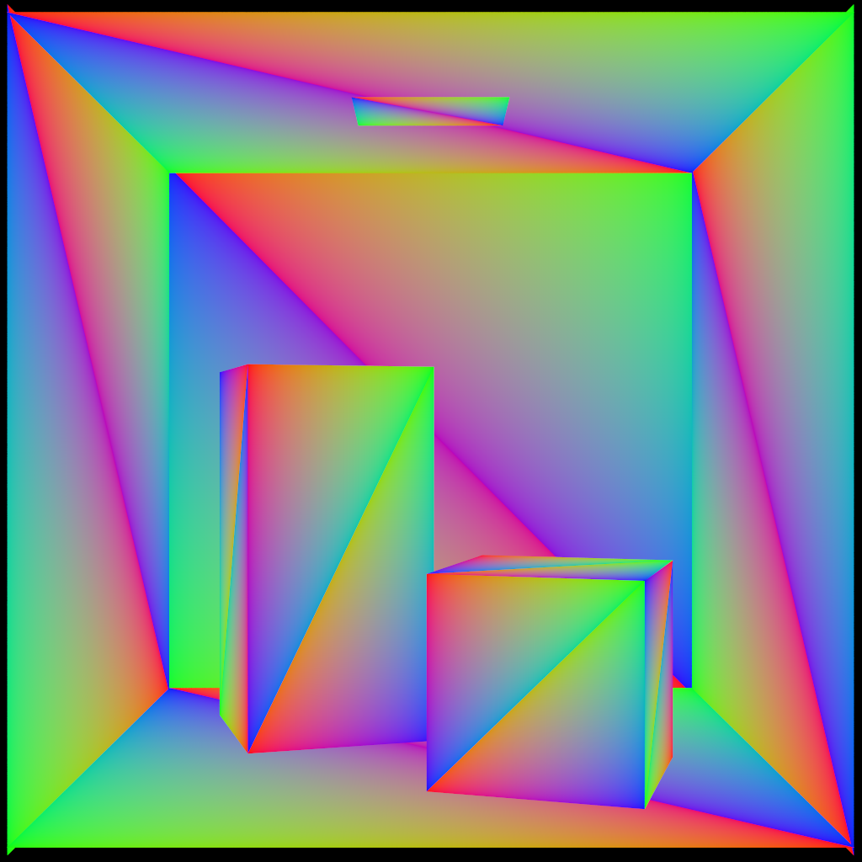
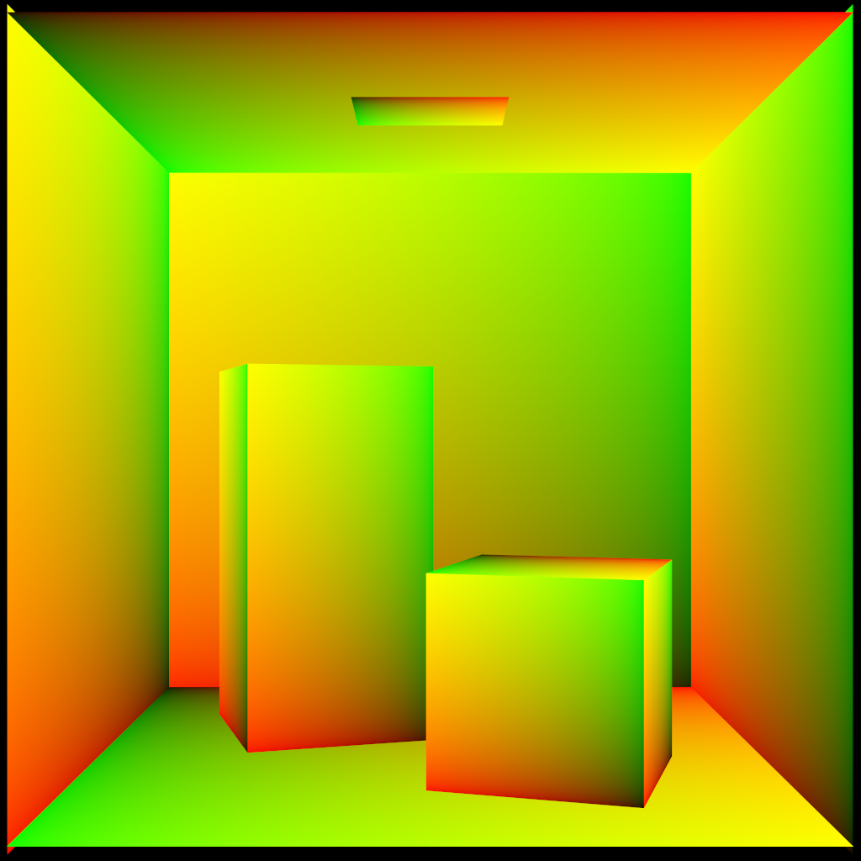
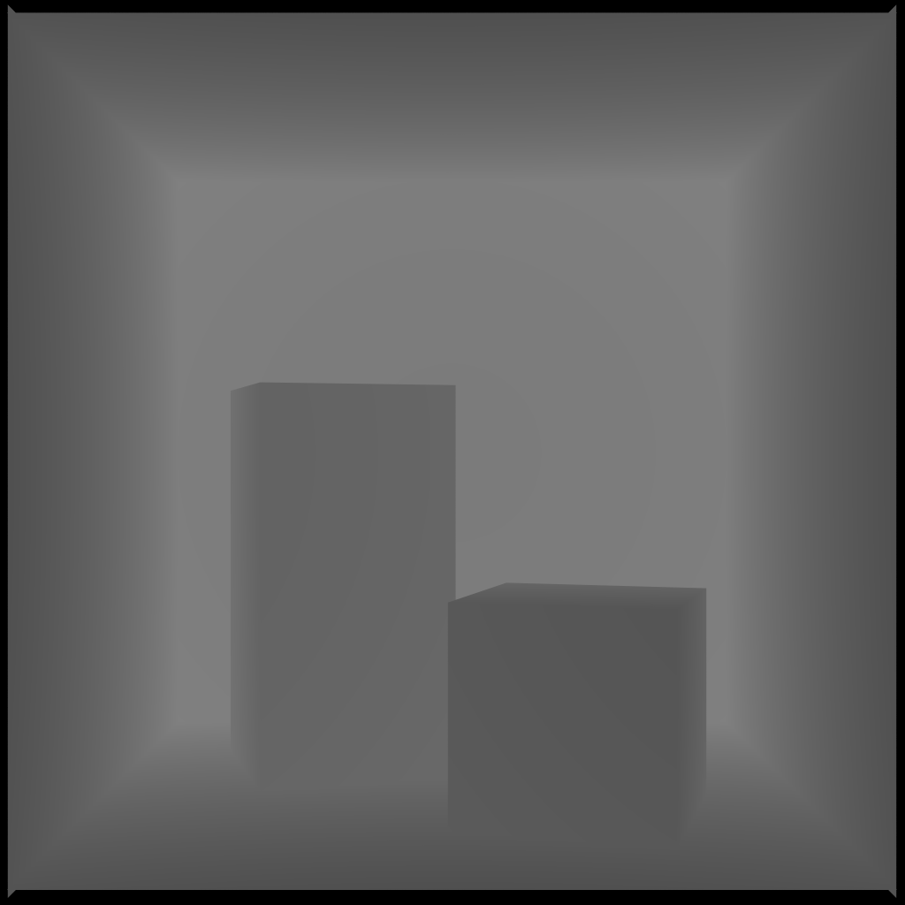
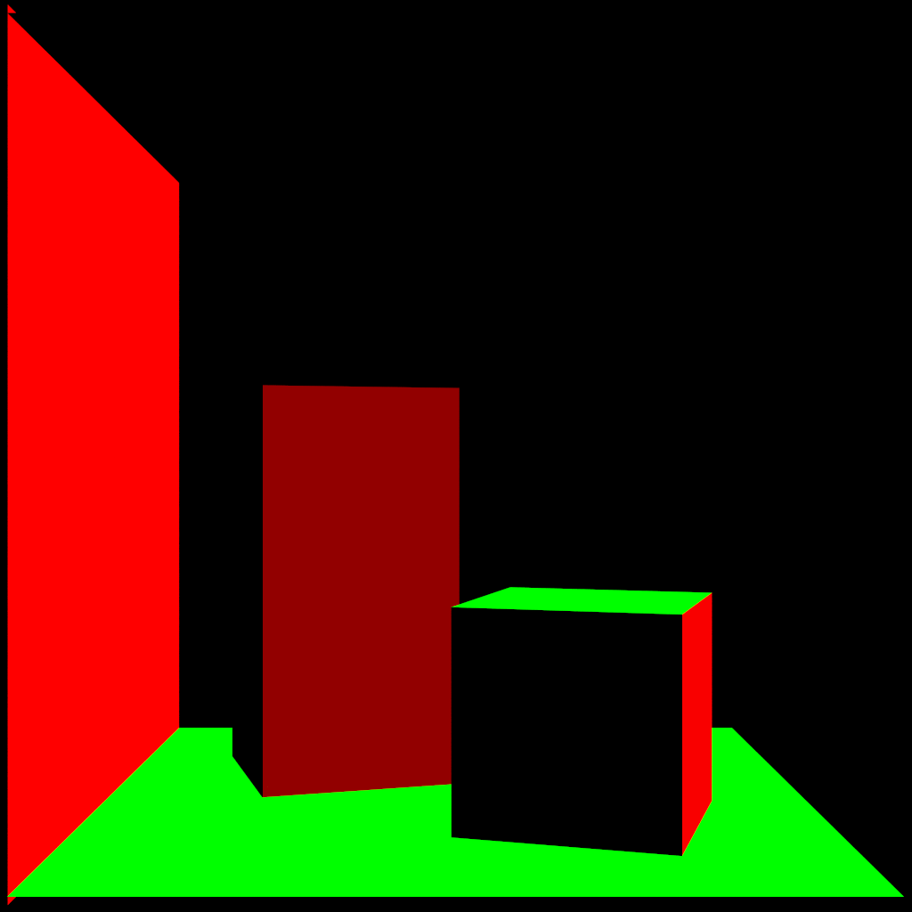
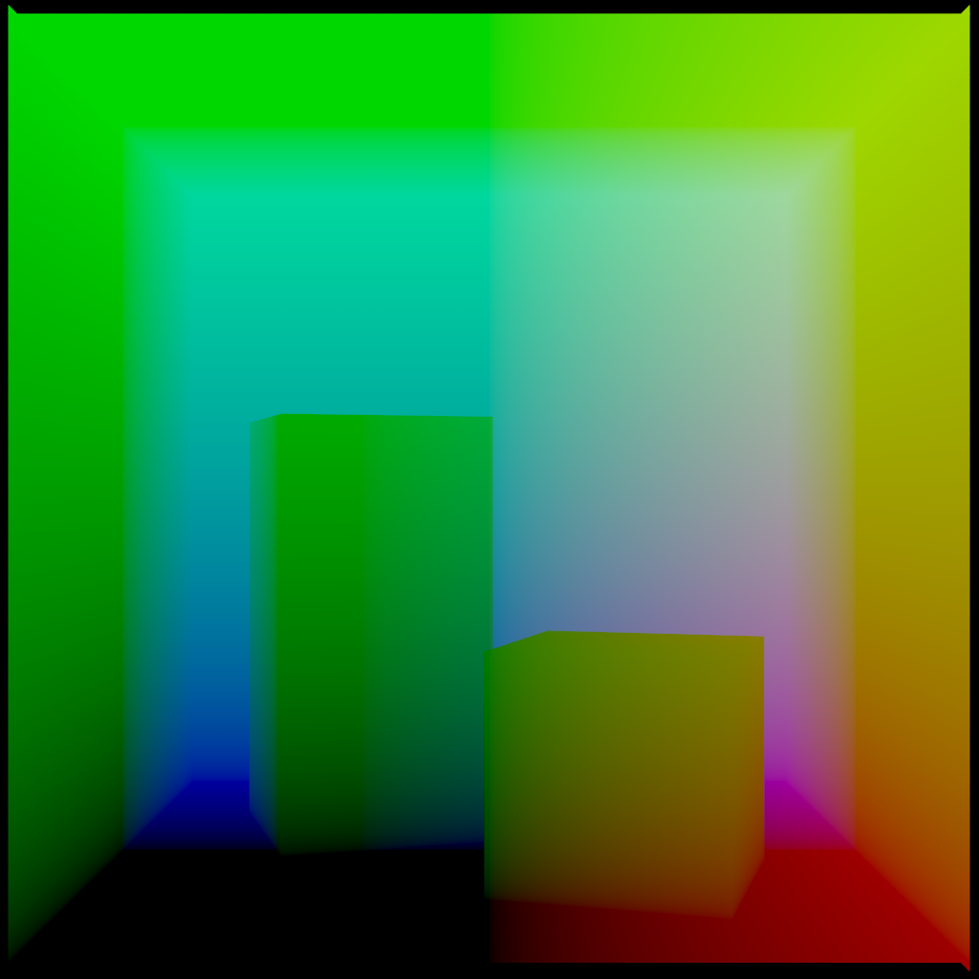
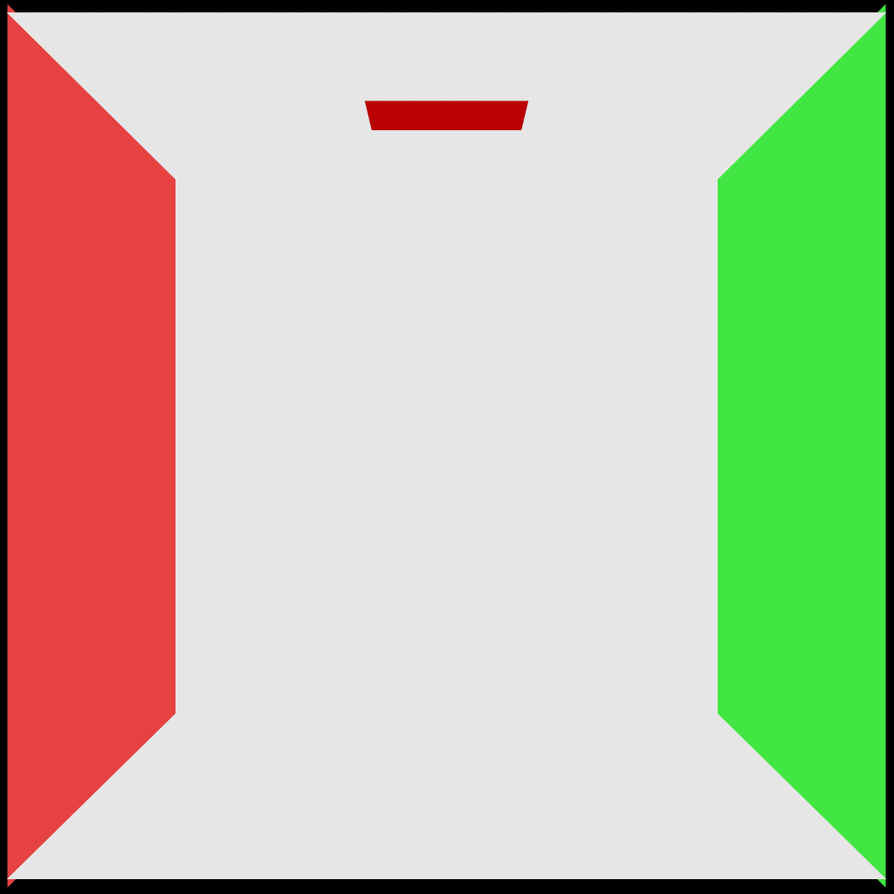
Rayground API – Hit Stage
rg_BaryCoords
rg_TexCoords
rg_Distance
rg_Normal
rg_Hitpoint
rg_MaterialProperty0

Slide 27
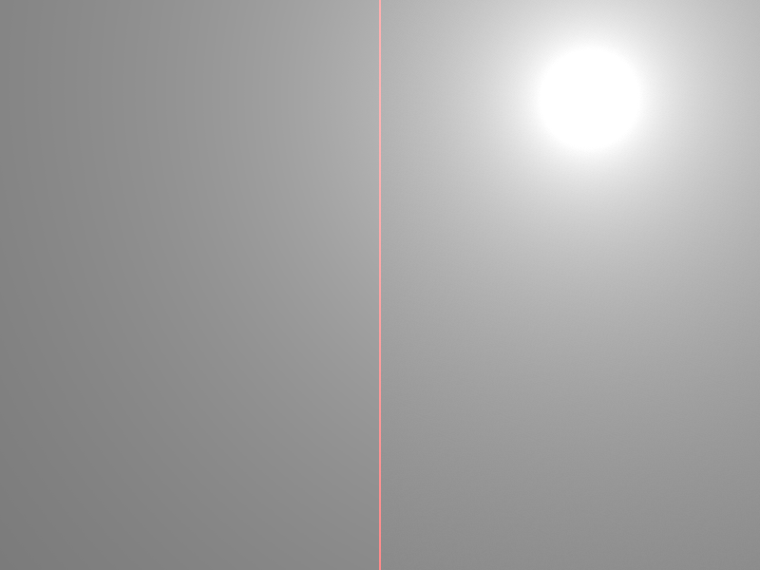

Rayground API – Miss Stage
Background Light Source
Sky Gradient

Slide 28
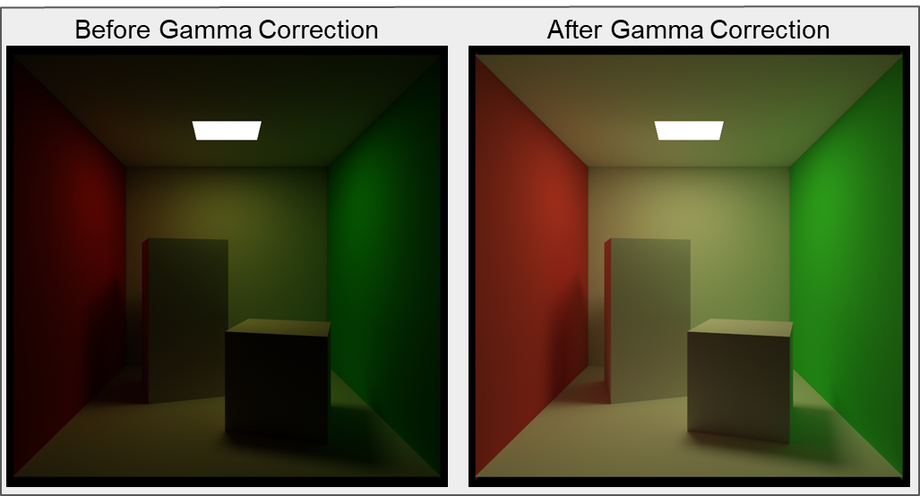
Rayground API – Post Process Stage
One of the most important steps in image synthesis. The user gains random access to the accumulation buffer. Typical use cases include:
Tone Mapping
Gamma Correction
Denoising

Slide 29
Where

Slide 30
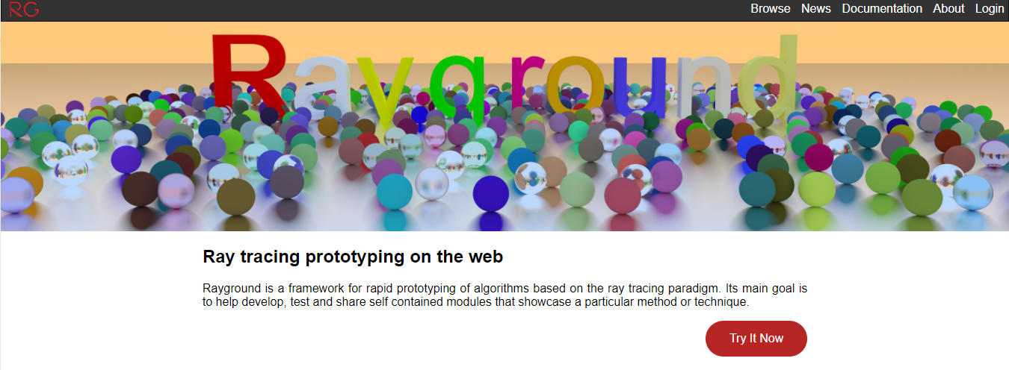
Rayground User Interface (1)
https://www.rayground.com/
Create your account

Slide 31
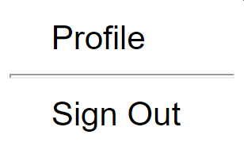
Rayground User Interface (2)
Enter to “My Projects” or to “My Profile”

Slide 32
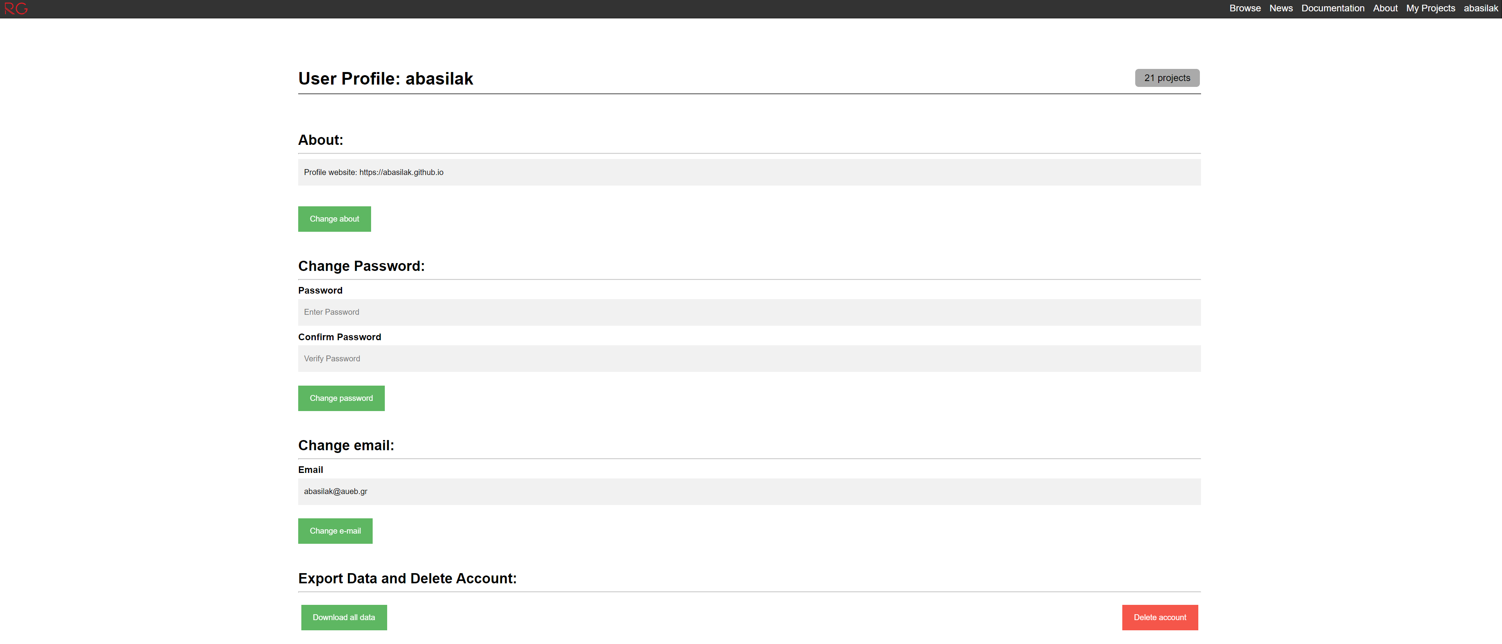
Rayground User Profile
Edit your profile details
Names and IDs

Slide 33
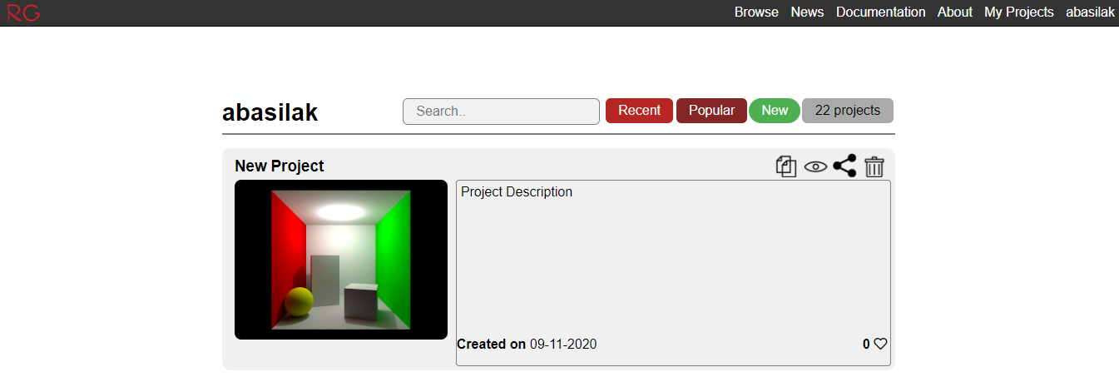
Rayground User Interface (3)
Create a “New” project
Rename/Insert Detail
Clone/Hide/Share/Delete
Press me

Slide 34
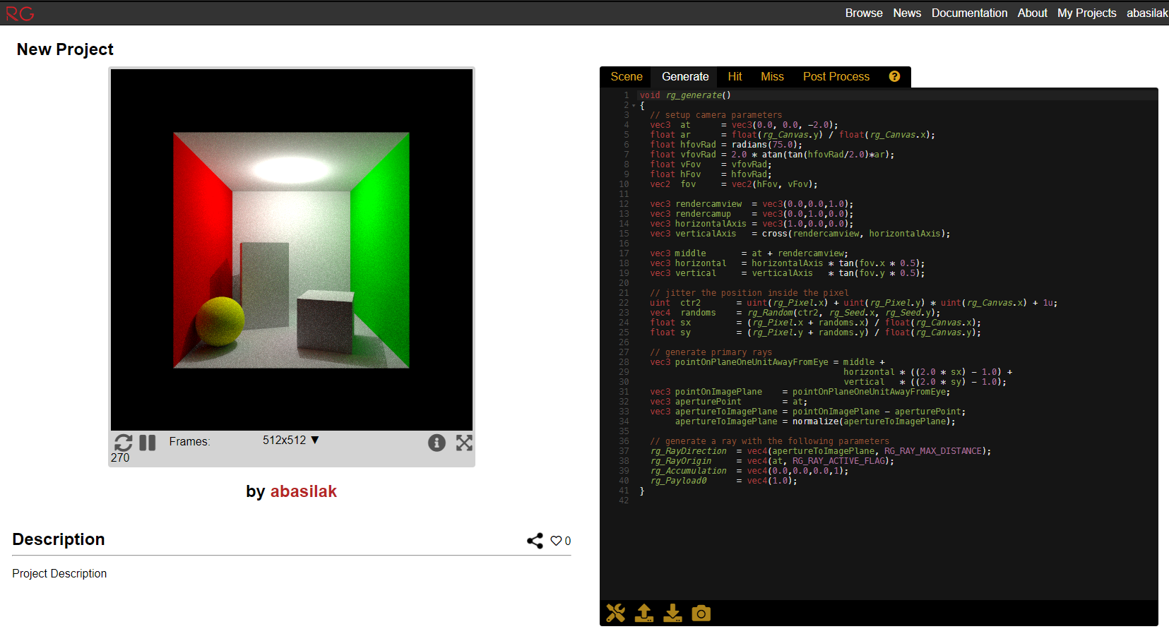
Rayground User Interface (4)
Stage Tabs
API
Canvas
Tools
Editor
Debug

Slide 35
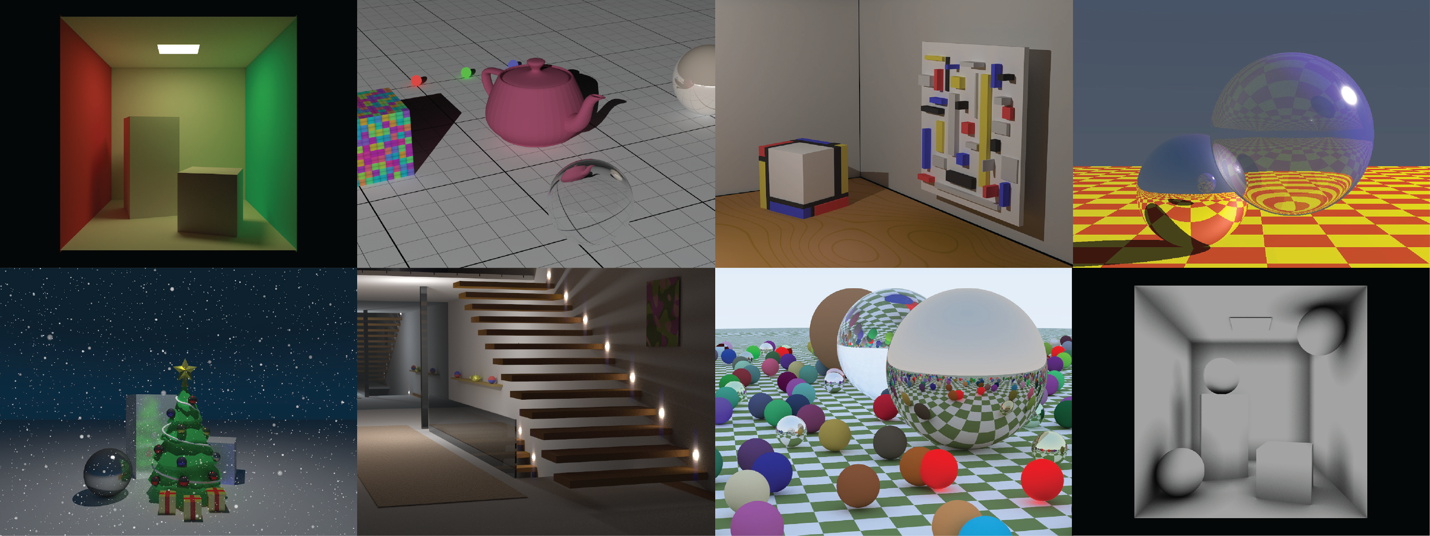
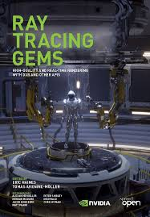
Further Resources
Start being familiar with Rayground / Extra Reading
Rayground
Ray Tracing Gems*
*Also check out RTR “Ray Tracing Chapter”: https://www.realtimerendering.com/Real-Time_Rendering_4th-Real-Time_Ray_Tracing.pdf

Slide 36
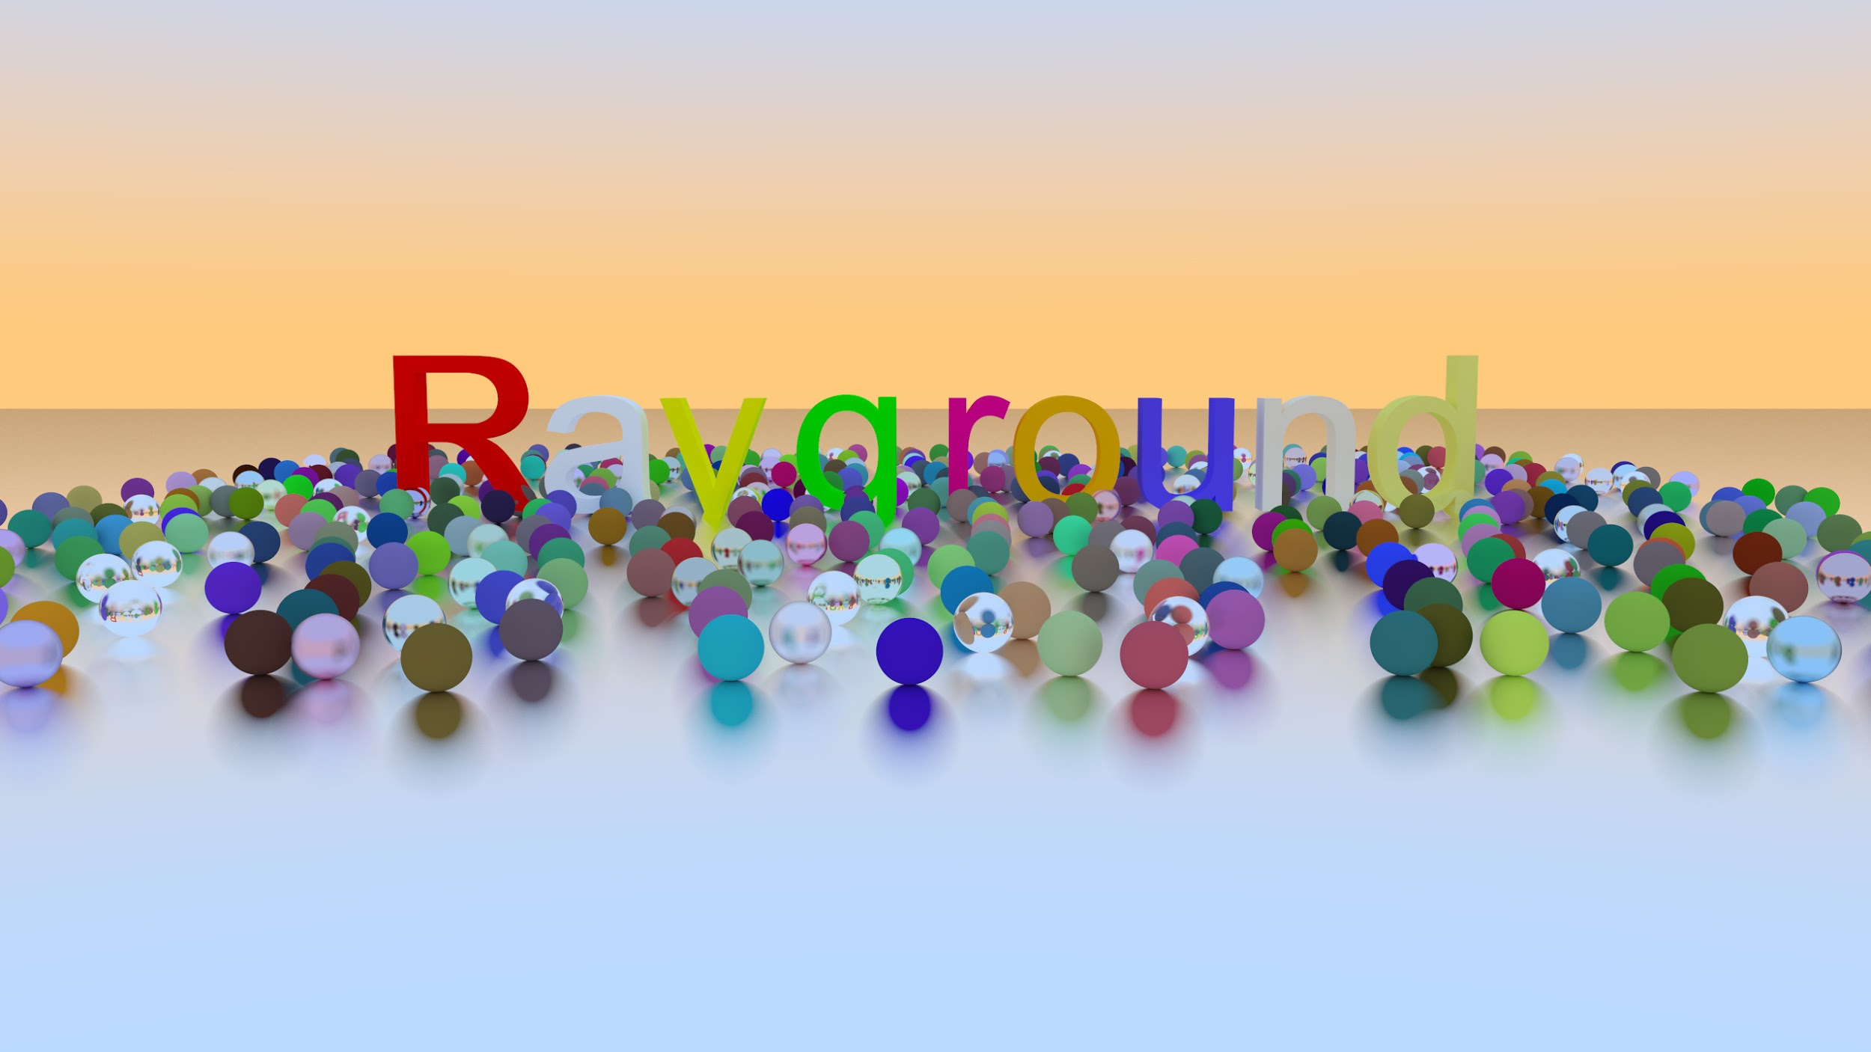



Q/A
https://www.rayground.com/
https://twitter.com/rayground_com
https://github.com/cgaueb/rayground

